Slide 1

Medical Imaging RPA System

Slide 2




Team Members
Zhenjie Zhou Yiwu Chen Yun Feng Fangyuan Huang

Slide 3
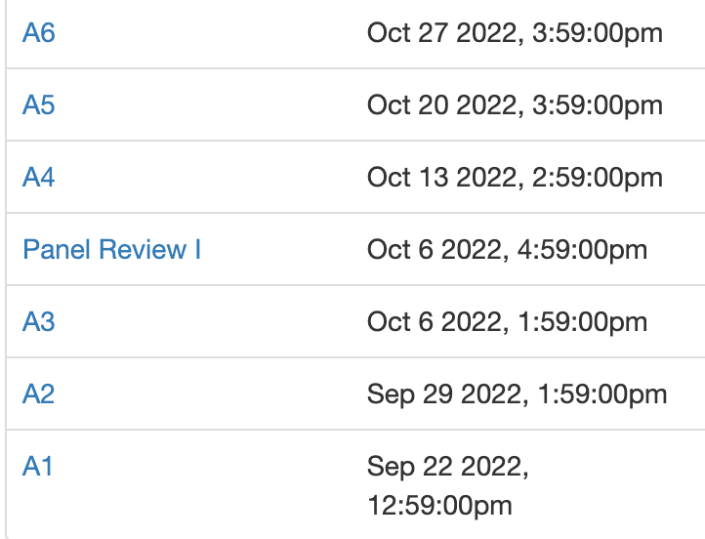
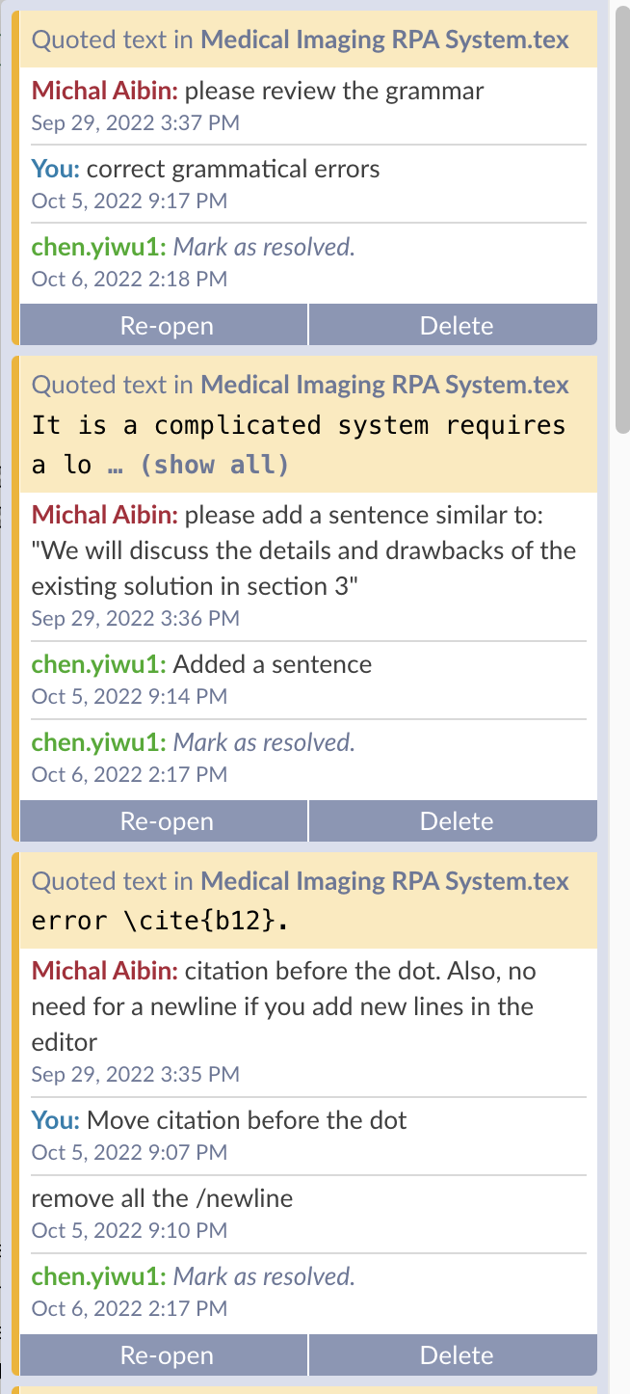
Previous feedback
Add citations
Add transition sentences
Improve summary
Add criteria and metric description
Notes:
We shared overleaf to draft our project report with academic committee and
Collect feedback from all 7 submissions
Conversation on the right shows how reviews were conducted by Professor Aibin and Correction made by our team

Slide 4
Motivation
Improve the accuracy (form classification)
Reduce repetitive manual tasks, improve work experience
Much faster, improve the efficiency of the system
Reduce the processing and response time, save lives
Notes:
- improve efficiency (faster ~ 8000 + request pending)
- improve work experience for staffs (reduce menial and repetitive tasks)
- save lives

Slide 5
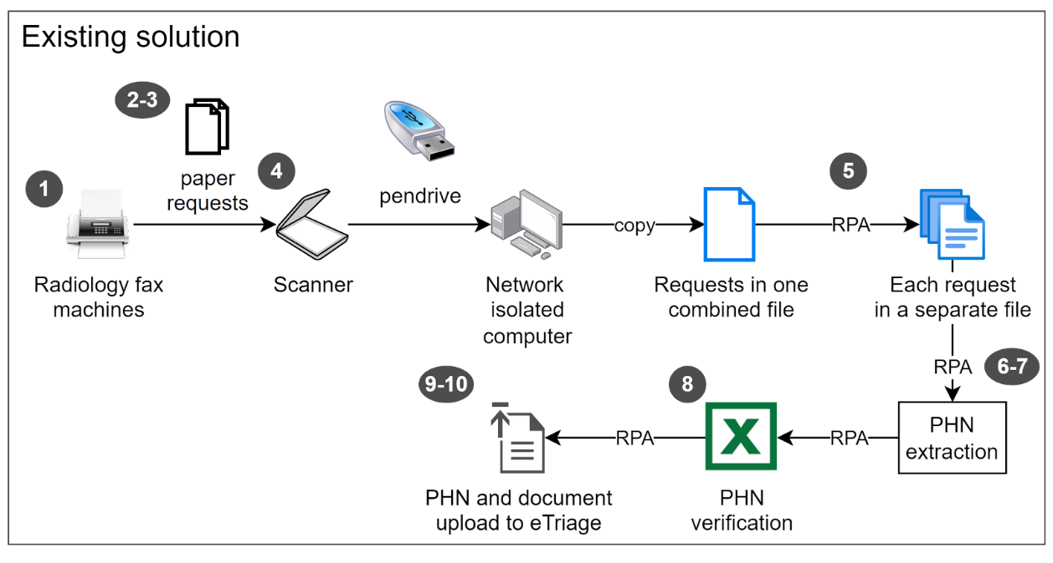
Problem Overview
Limitations:
- labor intense
- error prone
- slow!
- tedious work
Notes:
the existing solution requires heavy human labor, like step 1 to step 4, we need to scan faxes and send to isolated computers manually,
which is error prone and slow.
we identify this as the biggest step we can improve.

Slide 6
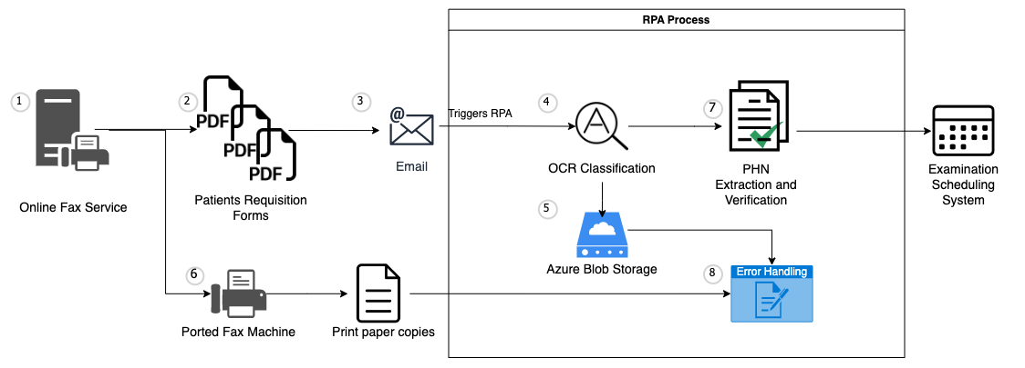
Problem Overview
Our Approach:
Improvements:
- Fast
- Automated
- Error handling
Notes:
In our proposed appraoch, we focus on removing the requirement of human labor, so we use a online fax service that able to save fax to files to the system, so in our system, whenever a request comes in, the system will direct the incoming request to a email and attach fax as attachment directly. Next, email will trigger a RPA process to save the pdf to a cloud server where OCR and downstream tasks will kick in, The whole procedure enables the distribution of incoming fax requests in real-time and greatly improve data quality and processing speed.In addition, our suggested solution utilizes the existing RPA process for PHN (Personal Health Number) extraction and verification,

Slide 7
My Input - Online Fax Service
Research and find the most suitable online fax service for the project
Automatic fax forwarding to email
Port to local fax number for local fax copies
Automatic store fax to local disk
Create Azure account and blob store and linked the services to the RPA services
Notes:
In this project, I worked on the automatic fax forwarding by using an online fax service. This serves as the entry point of our whole RPA process. We used an online fax service to replace the existing fax machine for better reliability and scalability. I did research on several popular online fax services and find the most suitable service for our project. I configured and tested the functionalities and make it able to forward fax to email, port to local number, save files to local disk. I also worked with team members to created cloud azure account and cloud blob store and linked the services to our PRA procedures.

Slide 8
My Input - Cost Analysis
Conduct cost analysis for the solutions
Solution 1 is expected to cost $770 per month at a monthly capacity of 7600 pages.
Alternative solution costs 40% lower with higher availability and security
Solution 1: RPA | Solution 2: Serverless Function (ongoing)
SRFax + PowerAutomate + Acquaforrest | SRFax + PowerAutomate + Azure Form Recognizer + Azure Functions
CAD $770 per month CAD $0.1 per page | CAD $450 per month CAD $0.06 per page
Notes:
I also compute the requests and storage requirement based on the given metrics, , and did cost analysis based the given metrics to calculate the monthly cost for online fax services, related cloud services.

Slide 9
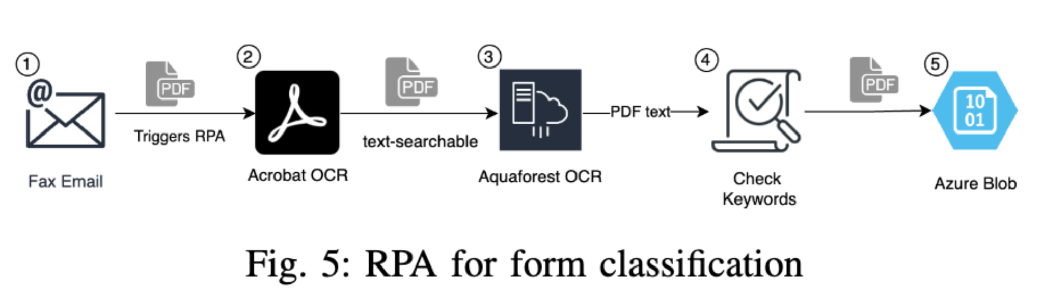
My Input - RPA Form Classification
When an email with pdf form arrives, triggers RPA
Acrobat OCR: generate text-searchable PDF
Aquaforest: get text from pdf
Check unique keywords, like ‘extremity’ for Ultrasound forms
Save to corresponding folder

Slide 10
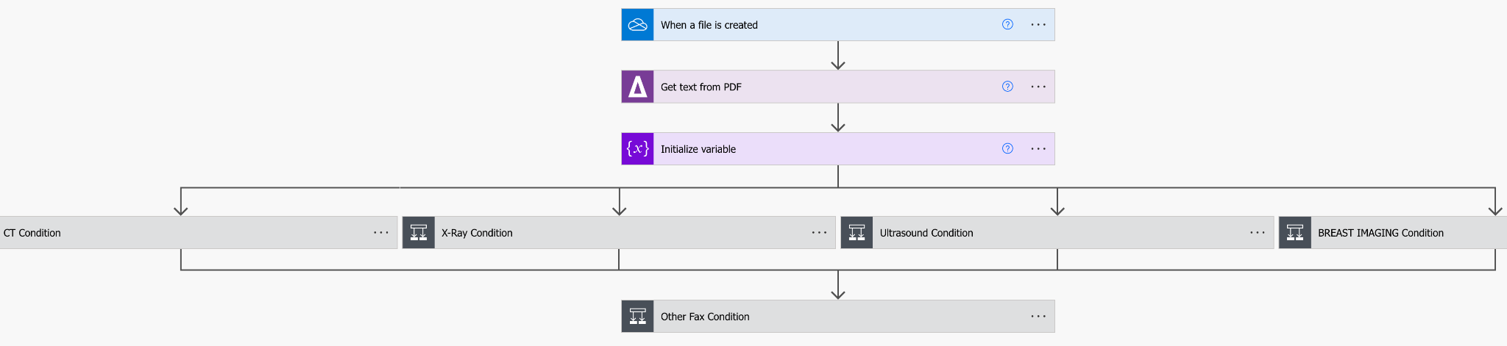
My Input - RPA Form Classification
RPA workflow

Slide 11
My Input - Fax Porting and Automation
Organize Weekly Meeting with stakeholders
On-premise fax machine operation
Connect online fax service with local fax
Test fax-to-email trigger for RPA process
Notes:
In terms of my contribution
Play a role in Project Management, draft MeetingMinutes at 30 pages
Include Reference on how to operate on-preme fax machine
Connect and test online fax service to email, and local porting shown at step 3 and 6

Slide 12
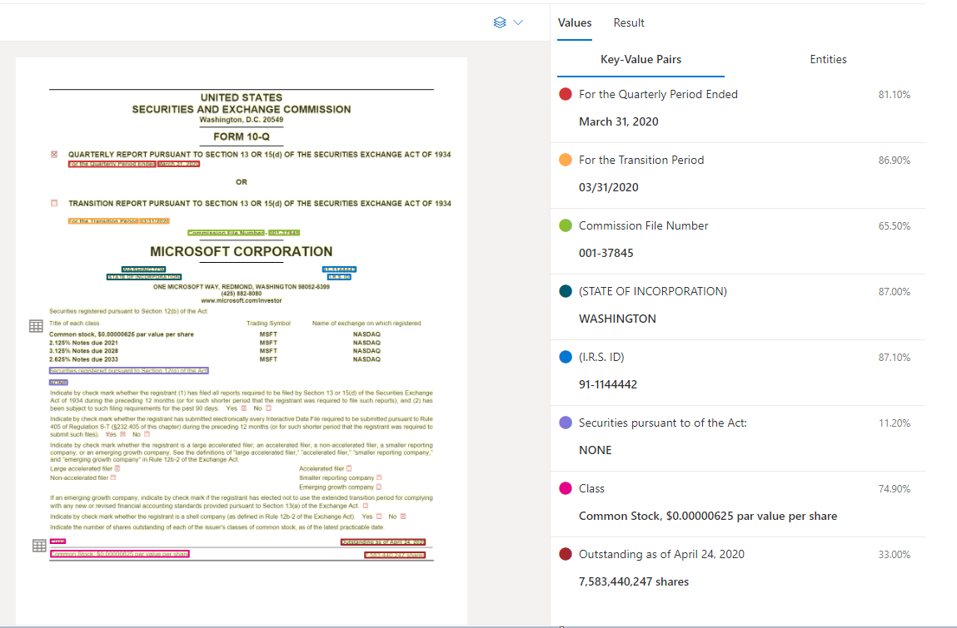
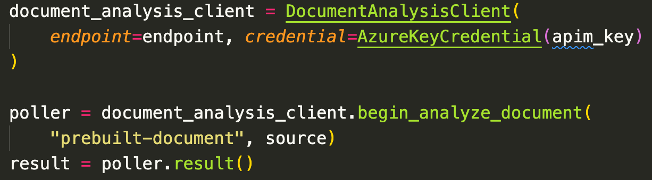
My Input - Serverless Development
Develop serverless solution at Azure
Evaluate different models on Azure Form Recognizer
Notes:
Architect serverless pipeline using Azure Function, Blob service, and Azure form recognzier
Diagnose Key-Value Pairs inferrenced by general document model, as example shown on the left
Connect with Azure Form Recognizer SDK and customize the document processing logics, as code snippet shown on the right

Slide 13
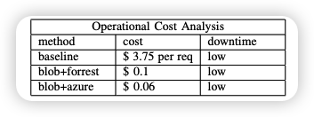
My Input - Metrics
Define baseline model
existing labor-intense solution
Measure in operation cost
unit in $ per request
availability and scalability
Measure in accuracy
dropout rate and classification accuracy
Notes:
other than regular meetings, writings, and debugging, my contribution focuses on 2 parts: metrics and error handling
first, I define the baseline model as the current existing model.
then, I lay the groundwork for metric definitions which helps us determine how successful our model is.
The metric mainly contains two parts:
first is operational cost. there are many dimension available. after some investigation and comparison, I found dollar per request to be the most direct and easy to understand metric
in addition, we also need to keep in mind about availability and scalability. the staff may be out of the office, and the system might go down. there are currently more than 8000 requests pending in the backlog. thus scaling up the bandwidth is not just a nice to have but more an urgent must have.
the second metric aspect is accuracy
due to the nature of medical service, accuracy is vital for our process. as mentioned by our stakeholder - "no patient shall be lost in the process". as a result, I believe our goal is a 0 dropout rate and 100% classification accuracy.

Slide 14
My Input - Error Handling
Error Handling: 3 critical checkpoints
1. Online Fax Service Error
2. OCR and Algo Error
3. Storage Error
Notes:
to achieve that 0 dropout rate and as high as possible accuracy, error handling is critically needed.
here is the error handling design validated by the stakeholder.
first we identify 3 critical checkpoints based on 3 potential vulnerabilities.
the first vulnerability is introduced by the online fax service
the second vulnerability comes from the ocr part. the ocr is not perfect and might make mistake.
the third vulnerability is the cloud storage. it might have down time and the saving process could go wrong.
To handle these vulnerabilities,staff members only need to come back every a period of time, sit down, match the numbers… make sure the total saved equals the total received, and double check to ensure each file is correctly classified.

Slide 15
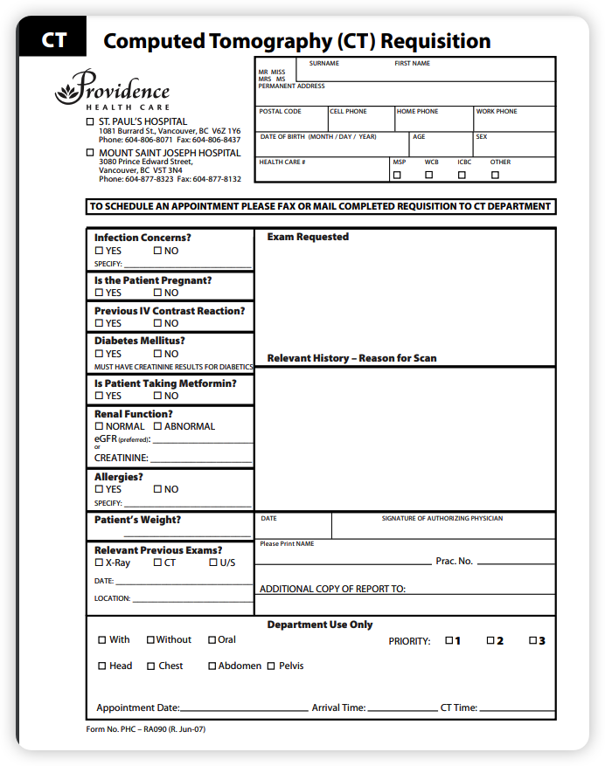
Simulation Plan
Gather form templates from public sources and stakeholder
Manually generate informations and fill templates to make a test set
Keep test set diverse and close to the actual workload
Apply test set to our RPA pipeline and measure metrics
Notes:
lastly, simulation plan
after communicating with the stakeholder, we came up with 4 steps for our simulation
1. gather form templates… for example on the right
2. manually fill templates…
3. diverse and close to actual
4. apply and measure

